Slide 1
Hotel Review Parsing: Pre and Post Pandemic
Data Science Masters Capstone
DATS 6501
Mariko McDougall

Slide 2

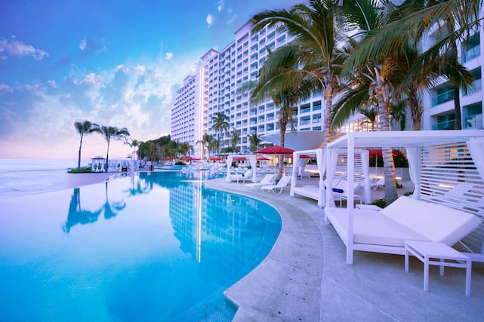
Index
Introduction
Literature Review
Methodology
Results and Analysis
Conclusions
References

Slide 3
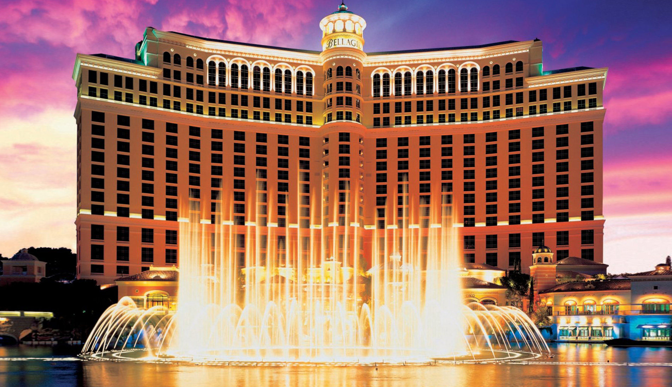
Introduction
The hotel industry, worth over 240 billion dollars globally*, was highly impacted by the Covid-19 pandemic.
Due to both health concerns and travel restrictions, occupancy declined more than 11%, and 4.4% of hotels permanently closed in 2020**.
*Strategic Report - Industry Overview 2020. IHG Hotels and Resorts - Annual reports. (2020).
**Q3 2021 US Hotel Figures. CBREUS Insights and Research. (2021).

Slide 4
Introduction - Problem Statement
Given the hotel industry’s intense competition for limited customers, knowing what factors have the highest impact on a visitor’s experience is critical to maintaining high review scores, satisfaction and occupancy.
Discerning critical factors may be particularly important now, as customer expectations and requirements may have shifted during the pandemic. For example, sanitation practices may now weigh customer opinions more heavily.
Factors will be compared from reviews written both before and during the pandemic, to discern if priorities have changed.

Slide 5
Literature Review
Citation | Impact
Alam, M. H., Ryu, W. J., & Lee, S-G. (2016). Joint multi-grain topic sentiment: Modeling semantic aspects for online reviews. Information Sciences, 339, 206-223. https://doi.org/10.1016/j.ins.2016.01.013 | Similar review-based dataset, using a tfidf-adjacent technique to predict star ratings of reviews. Used as a baseline of comparison for model accuracy.
Gaudette, L., Japkowicz, N. (2009). Evaluation Methods for Ordinal Classification. In: Gao, Y., Japkowicz, N. (eds) Advances in Artificial Intelligence. Canadian AI 2009. Lecture Notes in Computer Science(), vol 5549. Springer, Berlin, Heidelberg. https://doi.org/10.1007/978-3-642-01818-3_25 | Strongly recommends the use of MSE for ordinal multi-class classification evaluation, either in lieu of or in addition to accuracy.
“Combining Categorical and Numerical Features with Text in BERT · Chris McCormick.” n.d. Accessed March 3rd, 2022. https://mccormickml.com/2021/06/29/combining-categorical-numerical-features-with-bert/. | Guidance on integrating and quantifying non-text features for NLP modeling with transformers.
Bird, S., Klein, E., & Loper, E. (2009). Natural Language Processing with Python: Analyzing Text with the Natural Language Toolkit. O'Reilly Media, Inc. | NLTK book and package, used as primary textual data cleaning package, and reference for NLP materials
Clark, K., Luong, M. T., Le, Q. V., & Manning, C. D. (2020). Electra: Pre-training text encoders as discriminators rather than generators. arXiv preprint arXiv:2003.10555. | Source paper for ELECTRA, one of three transformer packages that will be used for the modeling.
Sun, Yu, Shuohuan Wang, Yukun Li, Shikun Feng, Hao Tian, Hua Wu, and Haifeng Wang. 2019. “ERNIE 2.0: A Continual Pre-Training Framework for Language Understanding.” ArXiv:1907.12412 [Cs], November. http://arxiv.org/abs/1907.12412. | Source paper for ERNIE 2.0, one of three transformer packages that will be used for the modeling.
He, Pengcheng, Xiaodong Liu, Jianfeng Gao, and Weizhu Chen. 2020. “DEBERTA: DECODING-ENHANCED BERT WITH DISENTANGLED ATTENTION.” In . https://openreview.net/forum?id=XPZIaotutsD. | Source paper for DeBERTa, one of three transformer packages that will be used for the modeling.

Slide 6
Methodology – Table of Contents
Data Collection
Data Pre-Processing
Tfidf Feature Extraction
Modeling
Transformer Models
Ensemble Model
Model Feature Engineering
Tfidf Feature Prediction
Novel Review Prediction

Slide 7

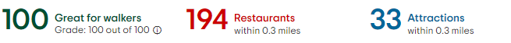
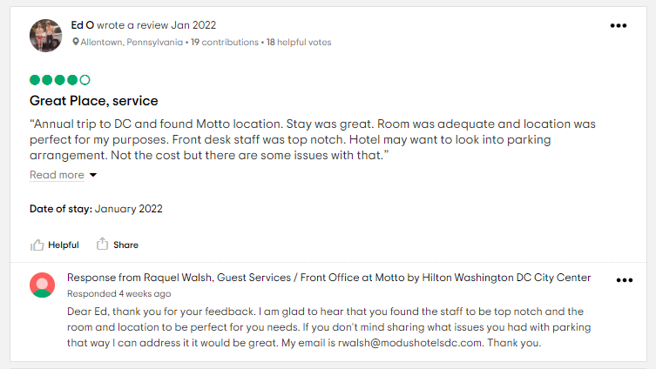
Methodology – Data Collection
Data scraped from TripAdvisor
All hotels from the most populous city in each state
Hotel ID
Used to join hotel and review data
Hotel Basic Information Section
Location Information
Review Information

Slide 8
Methodology – Data Preprocessing
Hotel Database
Reviews Database
Parse state from the hotel address
Some hotels served major cities, but were not technically within the city boundaries
eg, Paradise, NV and Las Vegas, NV
Text Processing
Title and review body combined
Tokenizing
Removing stop words
Lemmatizing
Removing punctuation, isolated numbers, etc
Date Processing
Dates parsed into datetime
Binary Review Written Pre/During Pandemic

Slide 9
Methodology – Tfidf Feature Extraction
TfidfVectorizer
Tf-idf : Term-frequency * Inverse Document Frequency
Scales down the impact of frequent tokens
CountVectorizer
Converts the cleaned tokens into a sparse matrix of token counts
Extract unigrams and bigrams
Individual words, and the individual word +1, captures relationships.
Maximum 10000 features
Ensures that uncommon words (typos, proper names) are not represented
TfidfTransformer
Converts the sparse matrix from CountVectoriser into tf-idf

Slide 10
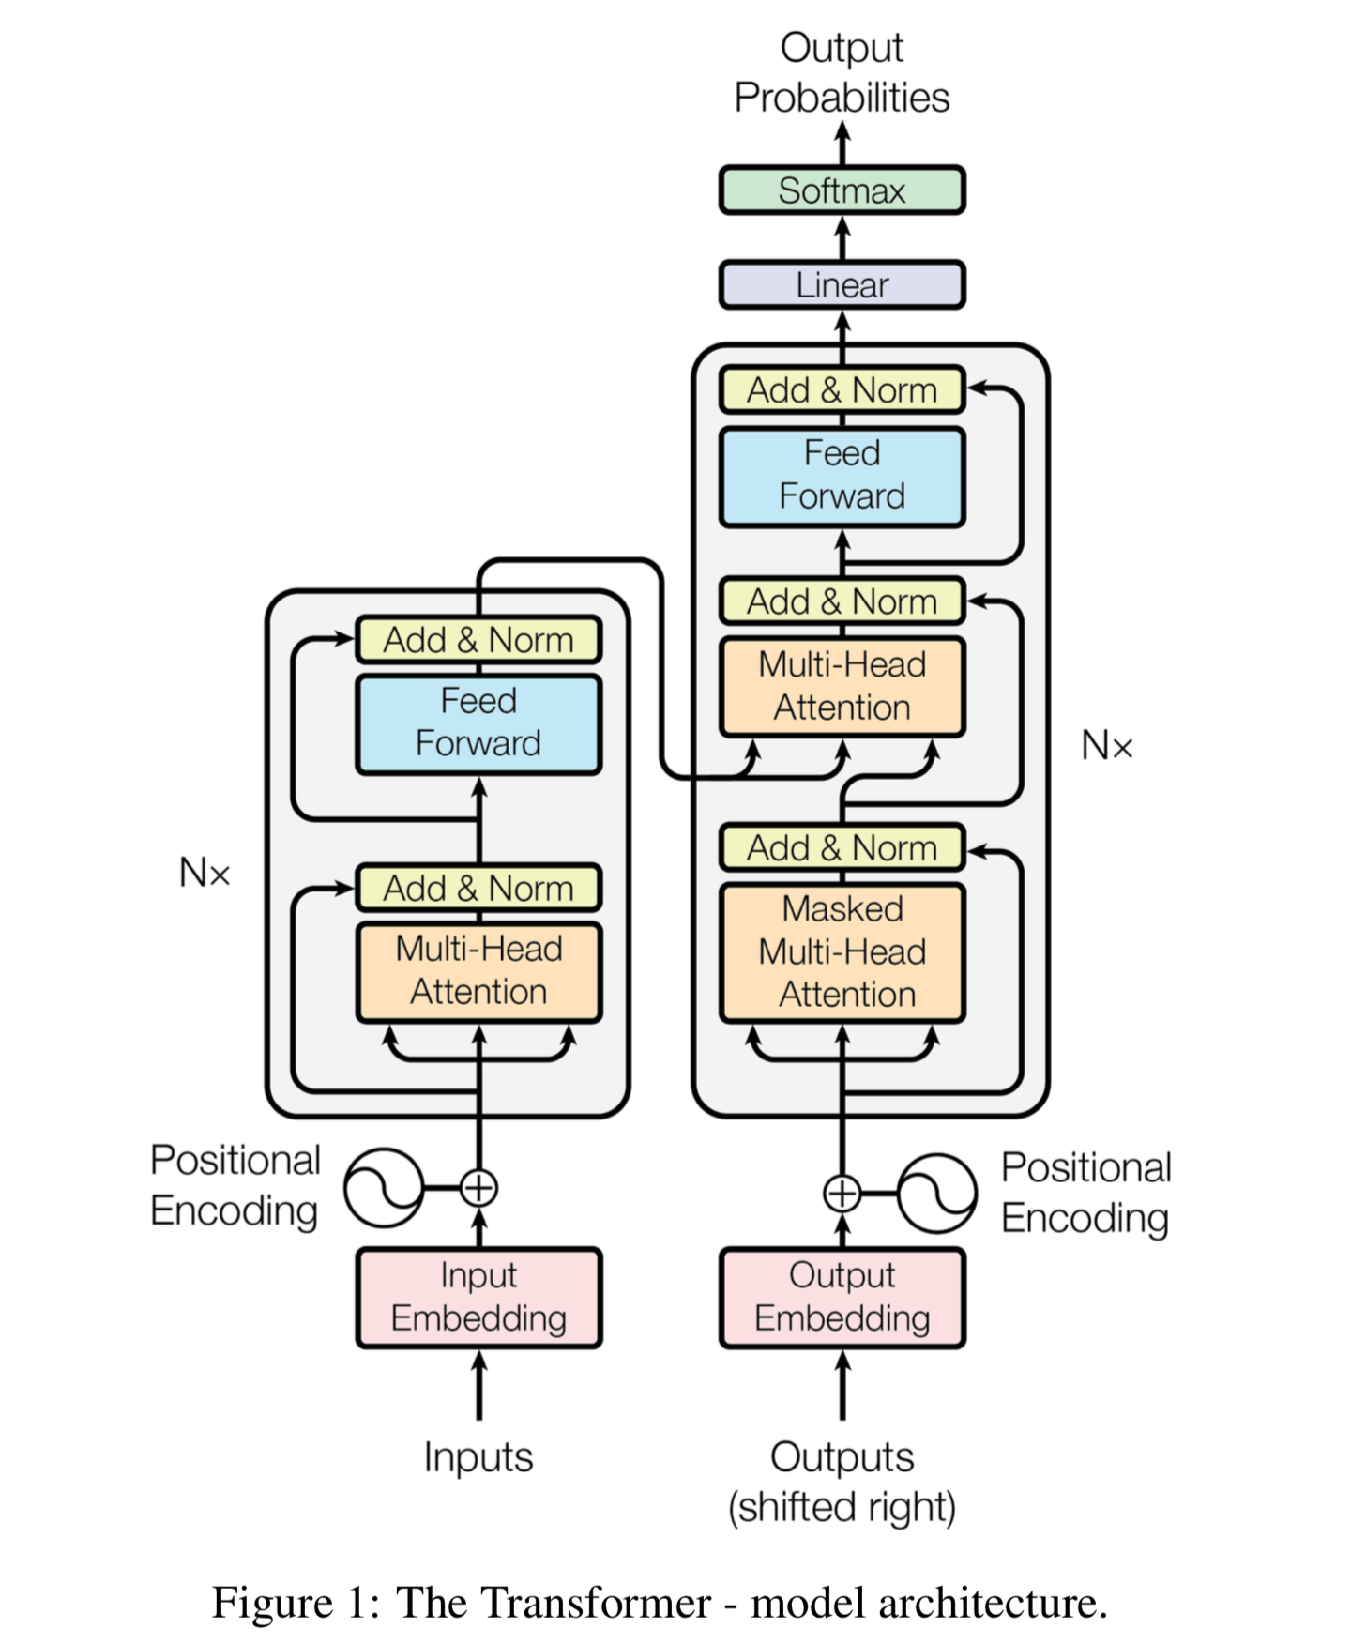
Methodology – Transformer Models
What is a Transformer model?
State-of-the-art NLP model
Processes text with context
Uses attention to weight the importance of each word in the sentence
Trained on huge corpuses of real text
All of Wikipedia
Needs to be fit to your data before running

Slide 11

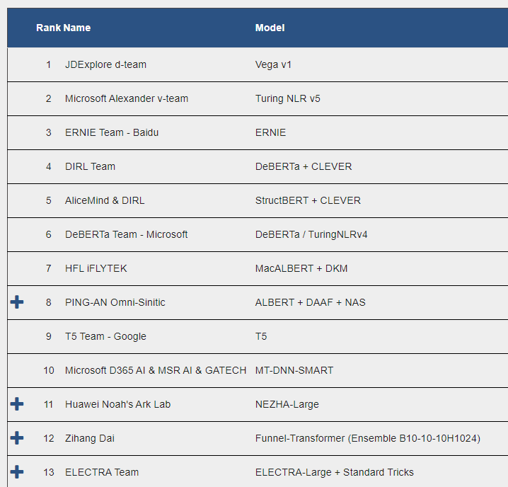
Methodology – Transformer Models
ELECTRA
Very lightweight model (110M parameters)
Uses replaced token detection, similar to a GAN network, rather than missing tokens
Performance exceeds human baselines (rank 21)
ERNIE 2.0
3rd ranked on the leaderboard
Much larger model than Electra (340M parameters)
Available as a transformer model
DeBERTa
4th ranked on the leaderboard (1.5B parameters)
BERT-based model – different base framework than ERNIE
Available as a transformer model
Vega v1
Current GLUE leader
Not available in the HuggingFace transformers library
No paper currently published
…
Notes:
Note: Didn’t use Turing because it is 530 billion parameters – just loading it would exceed computational capacity.

Slide 12
Methodology – Transformer Models
ELECTRA
Very lightweight model (110M parameters)
Uses replaced token detection, similar to a GAN network, rather than missing tokens
Performance exceeds human baselines (rank 21)
ERNIE 2.0
3rd ranked on the leaderboard
Much larger model than Electra (340M parameters)
Available as a transformer model
DeBERTa
4th ranked on the leaderboard (1.5B parameters)
BERT-based model – different base framework than ERNIE
Available as a transformer model
Vega v1
Current GLUE leader
Not available in the HuggingFace transformers library
No paper currently published
…
Notes:
Note: Didn’t use Turing because it is 530 billion parameters – just loading it would exceed computational capacity.

Slide 13
Methodology – Ensemble Models
Data
Ensemble Learning
Meta approach to modeling
Leverages the power of multiple predictive models
Gradient Boosting
Builds trees sequentially, with each tree being built in a chain.
Similar to a Random Forest
Build all trees simultaneously and independently (horizontally)
Model
Model
Model
Ensemble Model
Predictions

Slide 14
Methodology – Ensemble Models
Data
Ensemble Learning
Meta approach to modeling
Leverages the power of multiple predictive models
Gradient Boosting
Builds trees sequentially, with each tree being built in a chain.
Similar to a Random Forest
Build all trees simultaneously and independently (horizontally)
ELECTRA
ERNIE
DeBERTa
Gradient Boost
Predictions

Slide 15
Methodology – Model Feature Engineering
Non-text data features were incrementally added to the review body and prepended to the reviews.
Prepending to avoid truncation during modeling.
Features were integrated into the text as seen to the left
Review body: The full review body and title.
State: The US state the hotel was in.
Pandemic timing: Before or after the pandemic
Walkability score: Derived from TripAdvisor walkability score. Binned in 25 point increments.
For each feature added, an ERNIE model was trained and tested on a small sample and compared against a baseline trained on review only.
State [state].
[pandemic timing] pandemic.
Walkability [walkability score].
[tfidf feature] [sentiment].
[Review body]. ”
State NV. Before pandemic. Walkability 2. Clean and comfy. We were a late check in and had no problems at all. The room was clean and the bed was extremely comfortable.
State OH. After pandemic. Walkability 0. Poorly maintained. short sheets and towels and property looks run down. Love the outdoor basketball court though.
Notes:
Important to append before the review, or it may be truncated when sending to the model.

Slide 16
Methodology – Tfidf Feature Sampling
To generate a granular response to all tfidf features and hotel factors, standardized sentences were iteratively generated.
Features integrated into text as seen to the left
tfidf feature: A unique set of features from the top 100 tfidf features from the all reviews, pre-covid and post-covid review sets.
Sentiment: 20 synonyms for “good” or “bad” were used for each feature to sample positive and negative sentiment
State: the US state the hotel was in.
Pandemic timing: Before or after the pandemic
Walkability score: Derived from the TripAdvisor walkability score. Binned in 25 point increments.
State [state].
[pandemic timing] pandemic.
Walkability [walkability score].
[tfidf feature] [sentiment].
State KS. After pandemic. Walkability 1. Area deplorable.
State AZ. After pandemic. Walkability 0. Staff friendly subpar.
State ME. Before pandemic. Walkability 3. Food enchanting.
State NM. After pandemic. Walkability 2. Lobby entertaining.

Slide 17
Results – Table of Contents
Data Collection
Data Pre-Processing
Tfidf Feature Extraction
Modeling
Transformer Models
Ensemble Model
Model Feature Engineering
Tfidf Feature Prediction
Novel Review Prediction

Slide 18
Results & Analysis – Dataset Statistics
Statistic | Overall | Pre-Pandemic | Pandemic
Total Number of Hotels | 3,922 | - | -
Total Number of Reviews | 3,774,238 | 3,442,834 | 331,404
Mean Review Rating | 4.07 | 4.10 | 3.81
STD of Review Ratings | 1.19 | 1.16 | 1.50

Slide 19
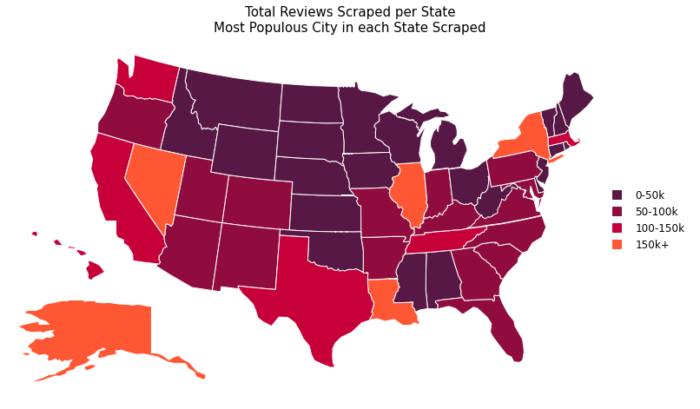
Results & Analysis – Reviews by State
Notes:
Min value: Mississippi with 8310 reviews, max Nevada with 299,316

Slide 20
Results & Analysis – Tfidf Feature Extraction
Ranking | Full Dataset | Pre-Pandemic | Pandemic
0 | hotel | hotel | room
1 | room | room | hotel
2 | great | great | great
3 | stay | stay | stay
4 | staff | staff | staff
5 | nice | nice | clean
6 | location | location | nice
7 | good | good | service
8 | clean | clean | location
9 | breakfast | breakfast | time
10 | service | service | good

Slide 21
Results & Analysis – Tfidf Feature Extraction
Ranking | Full Dataset | Pre-Pandemic | Pandemic
0 | hotel | hotel | room
1 | room | room | hotel
2 | great | great | great
3 | stay | stay | stay
4 | staff | staff | staff
5 | nice | nice | clean
6 | location | location | nice
7 | good | good | service
8 | clean | clean | location
9 | breakfast | breakfast | time
10 | service | service | good

Slide 22
Results & Analysis – Model Feature Engineering
Features | Accuracy | MSE
Predict most frequent rating | 0.4890 | 2.4124
Review body only | 0.730490 | 0.31500
Review body + Pandemic Timing | 0.7295098 | 0.31323
Review body + Pandemic Timing + State | 0.72539 | 0.321764
Review body + Pandemic Timing + State + Walkability | 0.73127 | 0.31931

Slide 23
Results & Analysis – Ensemble Results
Baseline | Accuracy | MSE
Electra | 0.735 | 0.312
Ernie | 0.729 | 0.328
DeBERTa | 0.731 | 0.320
Electra + Ernie + DeBERTa GradientBoost Ensemble | 0.740 | 0.305
Notes:
Part of what makes the results very similar, and the ensemble less effective than expected is that they often made errors on the same test cases. These were often reviews that had discordant review ratings and text, or ones with edits that change the rating dramatically, but are short in length.

Slide 24
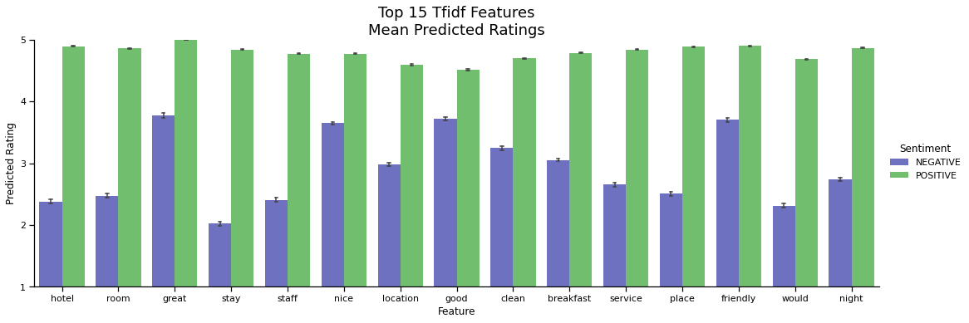
Results & Analysis – Tfidf Feature Sampling

Slide 25
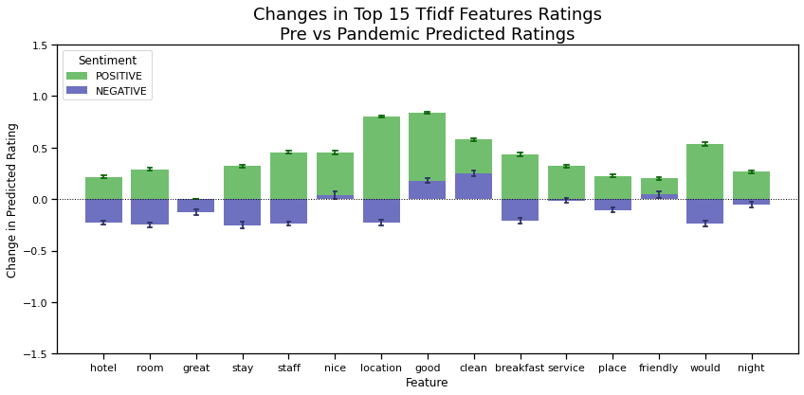
Results & Analysis – Tfidf Feature Sampling

Slide 26
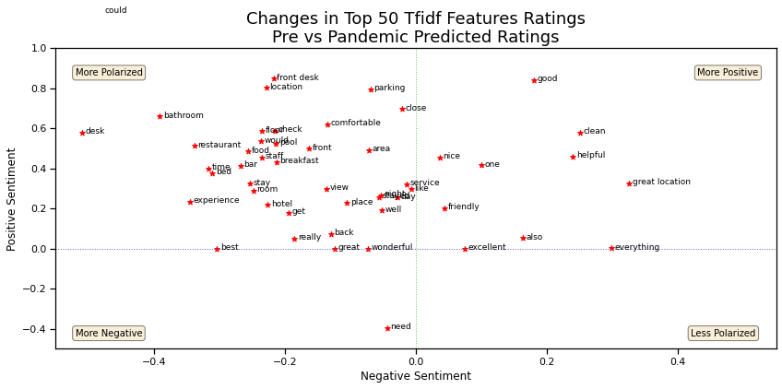
Results & Analysis – Tfidf Feature Sampling

Slide 27
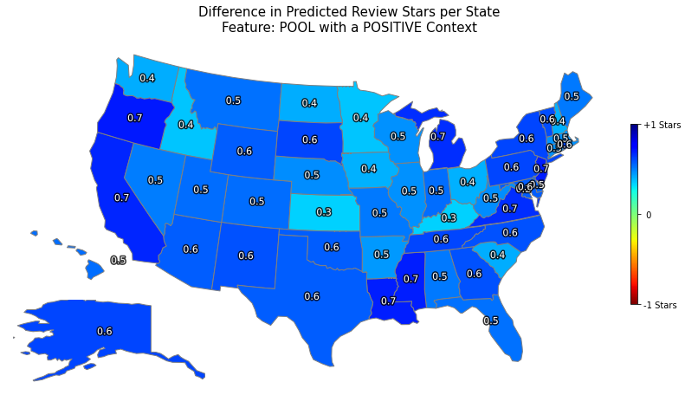
Results & Analysis – Tfidf Feature Sampling

Slide 28
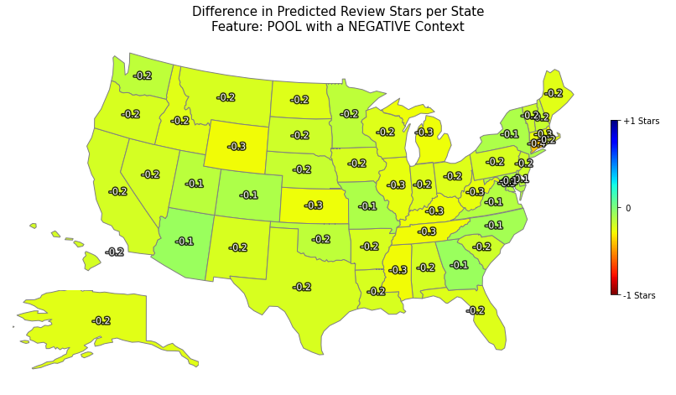
Results & Analysis – Tfidf Feature Sampling

Slide 29
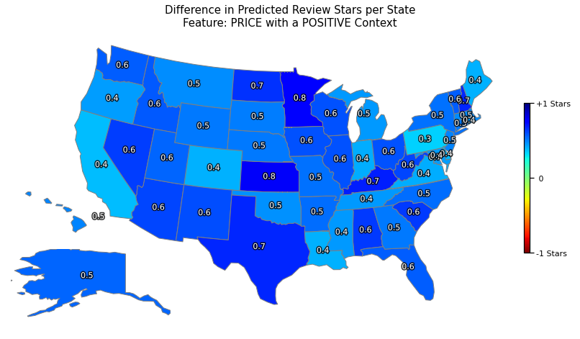
Results & Analysis – Tfidf Feature Sampling

Slide 30
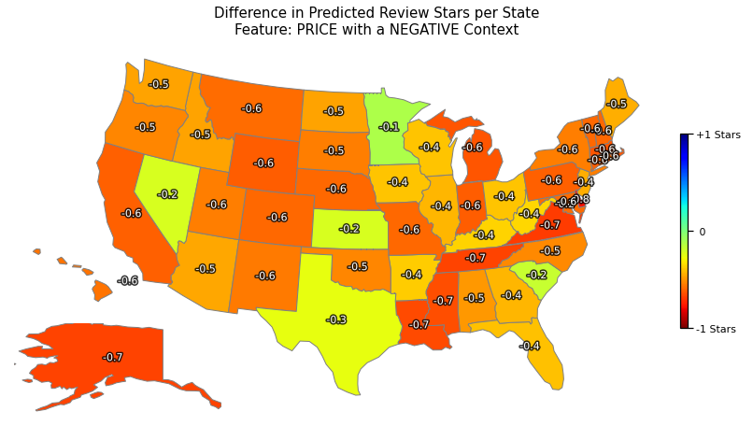
Results & Analysis – Tfidf Feature Sampling

Slide 31
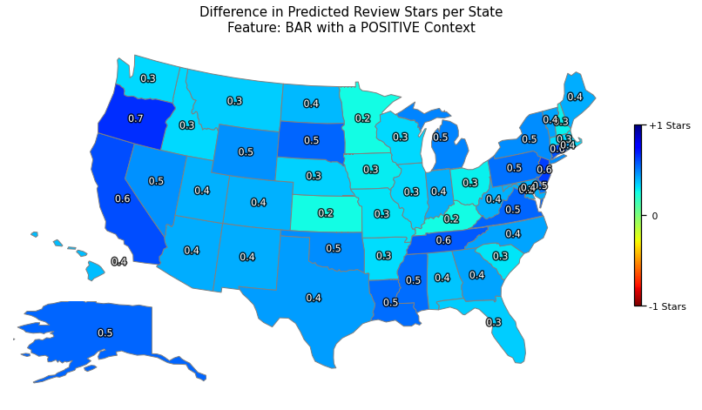
Results & Analysis – Tfidf Feature Sampling

Slide 32
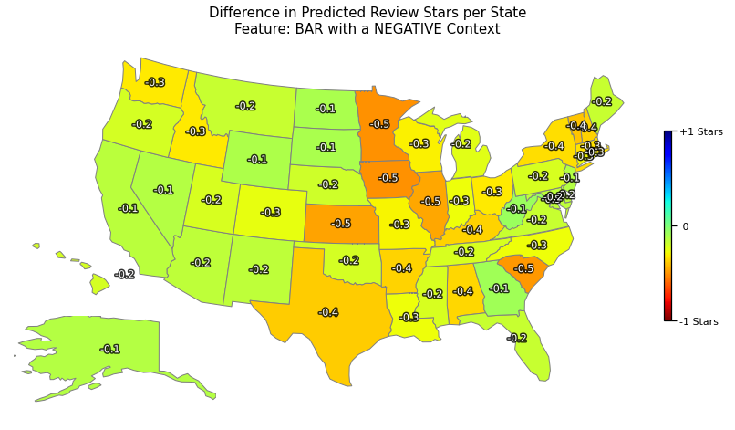
Results & Analysis – Tfidf Feature Sampling

Slide 33
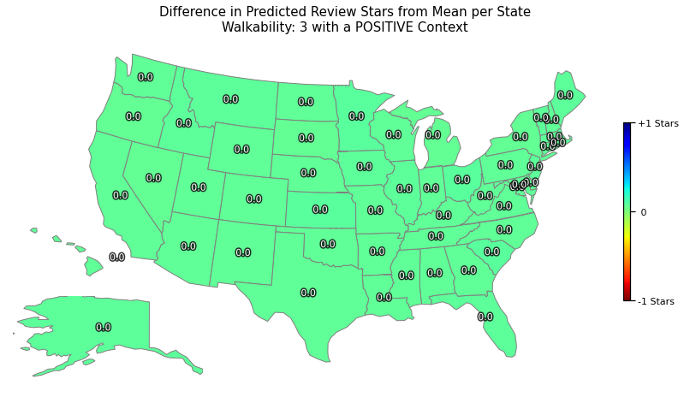
Results & Analysis – Walkability
Walkability and Review Score
Pearson’s Correlation: 0.122
Frequency of High Walkability and Review Score
Pearson’s Correlation: 0.463

Slide 34
Results & Analysis – Novel Sentences
Sentence | Electra | Ernie | DeBERTa | Ensemble
The lobby in this hotel is dated. | 2 | 2 | 1 | 2
The lobby in this hotel is newly renovated. | 3 | 4 | 4 | 4
The lobby in this hotel is very clean. | 3 | 4 | 4 | 4
The lobby in this hotel is newly painted | 3 | 3 | 4 | 3
The lobby in this hotel has free coffee. | 3 | 3 | 3 | 3

Slide 35
Conclusions
Predicted Tfidf Feature Importance
Different features of reviews have variable impacts on the predicted ratings
This impact can be further differentiated into positive and negative context.
During the pandemic:
Regional Predicted Tfidf Feature Importance
Regionality plays a strong role in determining rating for a given feature
Staff friendliness is more important in [INSERT LOCATION] than [INSERT LOCATION]
During the pandemic:
Modeling
Integration of non-text features helps inform transformers models, and can lead to more accurate results than the text in isolation.
Ensembling helps to increase performance of multiple models, and leads to a more moderate prediction than a model in isolation

Slide 36
Project Limitations & Future Research
Limitations
A character limit on both Electra and Ernie truncated longer reviews
This also imposes a limit on the number of features that can be added
Computational resources were limited to those within budget (Google Colab Pro)
Interactive instances could not be left running for prolonged periods without confirming monitoring
Limited the training times to approx. 12 hour bursts
Future Research
Implementing more models in the ensemble
Using larger versions of the models in the ensemble
Implementing more samples into the training sets

Slide 37
References
Bird, S., Klein, E., & Loper, E. (2009). Natural Language Processing with Python: Analyzing Text with the Natural Language Toolkit. O'Reilly Media, Inc.
Clark, K., Luong, M. T., Le, Q. V., & Manning, C. D. (2020). Electra: Pre-training text encoders as discriminators rather than generators. arXiv preprint arXiv:2003.10555.
Guo, S.; Wang, Q. Application of Knowledge Distillation Based on Transfer Learning of ERNIE Model in Intelligent Dialogue Intention Recognition. Sensors 2022, 22, 1270. https://doi.org/10.3390/s22031270
Vivek, S. (2018, December 17). Automated keyword extraction from articles using NLP. Medium. Retrieved February 10, 2022, from https://medium.com/analytics-vidhya/automated-keyword-extraction-from-articles-using-nlp-bfd864f41b34
Strategic Report - Industry Overview 2020. IHG Hotels and Resorts - Annual reports. (2020). Retrieved January 20, 2022, from https://www.ihgplc.com/-/media/FBBD6EBDD4D14EAD88A08E62F7911E74.ashx
Q3 2021 US Hotel Figures. CBREUS Insights and Research. (2021). Retrieved January 21, 2022, from Q3 2021 US Hotel Figures

Slide 38
References
“5. Categorizing and Tagging Words.” n.d. Accessed April 11, 2022. https://www.nltk.org/book/ch05.html.
Alam, Md Hijbul, Woo Jong Ryu, and Sang-Geun Lee. 2016a. “Joint Multi-Grain Topic Sentiment: Modeling Semantic Aspects for Online Reviews.” Information Sciences 339 (April): 206–23. https://doi.org/10.1016/j.ins.2016.01.013.
———. 2016b. “Joint Multi-Grain Topic Sentiment: Modeling Semantic Aspects for Online Reviews.” Information Sciences 339 (April): 206–23. https://doi.org/10.1016/j.ins.2016.01.013.
Baccianella, Stefano, Andrea Esuli, and Fabrizio Sebastiani. 2009. “Evaluation Measures for Ordinal Regression.” In 2009 Ninth International Conference on Intelligent Systems Design and Applications, 283–87. https://doi.org/10.1109/ISDA.2009.230.
Boyagane, Isuru. 2020. “How Important Are the Words in Your Text Data? Tf-Idf Answers….” Medium. December 24, 2020. https://towardsdatascience.com/how-important-are-the-words-in-your-text-data-tf-idf-answers-6fdc733bb066.
Clark, Kevin, Minh-Thang Luong, and Quoc V Le. 2020. “ELECTRA: PRE-TRAINING TEXT ENCODERS AS DISCRIMINATORS RATHER THAN GENERATORS,” 18.
“Combining Categorical and Numerical Features with Text in BERT · Chris McCormick.” n.d. Accessed April 11, 2022a. https://mccormickml.com/2021/06/29/combining-categorical-numerical-features-with-bert/.
“———.” n.d. Accessed April 10, 2022b. https://mccormickml.com/2021/06/29/combining-categorical-numerical-features-with-bert/.
“Correcting Words Using NLTK in Python.” 2021. GeeksforGeeks (blog). July 18, 2021. https://www.geeksforgeeks.org/correcting-words-using-nltk-in-python/.
“Feature Extraction Techniques - NLP.” 2020. GeeksforGeeks (blog). March 3, 2020. https://www.geeksforgeeks.org/feature-extraction-techniques-nlp/.
Figueroa, Rosa L., Qing Zeng-Treitler, Sasikiran Kandula, and Long H. Ngo. 2012. “Predicting Sample Size Required for Classification Performance.” BMC Medical Informatics and Decision Making 12 (1): 8. https://doi.org/10.1186/1472-6947-12-8.
Ganesan, Kavita. 2018. “Python Keyword Extraction Tutorial Using TF-IDF.” Kavita Ganesan, PhD (blog). August 2, 2018. https://kavita-ganesan.com/python-keyword-extraction/.
Gaudette, Lisa, and Nathalie Japkowicz. 2009a. “Evaluation Methods for Ordinal Classification.” In Advances in Artificial Intelligence, edited by Yong Gao and Nathalie Japkowicz, 207–10. Berlin, Heidelberg: Springer. https://doi.org/10.1007/978-3-642-01818-3_25.
———. 2009b. “Evaluation Methods for Ordinal Classification.” In Advances in Artificial Intelligence, edited by Yong Gao and Nathalie Japkowicz, 207–10. Berlin, Heidelberg: Springer. https://doi.org/10.1007/978-3-642-01818-3_25.
Hao, Yaru, Li Dong, Hangbo Bao, Ke Xu, and Furu Wei. 2021. “Learning to Sample Replacements for ELECTRA Pre-Training.” In Findings of the Association for Computational Linguistics: ACL-IJCNLP 2021, 4495–4506. Online: Association for Computational Linguistics. https://doi.org/10.18653/v1/2021.findings-acl.394.
He, Pengcheng, Xiaodong Liu, Jianfeng Gao, and Weizhu Chen. 2020. “DEBERTA: DECODING-ENHANCED BERT WITH DISENTANGLED ATTENTION.” In . https://openreview.net/forum?id=XPZIaotutsD.
———. 2021. “DeBERTa: Decoding-Enhanced BERT with Disentangled Attention.” ArXiv:2006.03654 [Cs], October. http://arxiv.org/abs/2006.03654.
“Hugging Face – The AI Community Building the Future.” n.d. Accessed April 11, 2022. https://huggingface.co/.
Nageshkar, Prasad. 2021. “Multi-Label Text Classification Using Transformers(BERT).” Analytics Vidhya (blog). March 15, 2021. https://medium.com/analytics-vidhya/multi-label-text-classification-using-transformers-bert-93460838e62b.
Rajapakse, Thilina. 2020. “Understanding ELECTRA and Training an ELECTRA Language Model.” Medium. April 12, 2020. https://towardsdatascience.com/understanding-electra-and-training-an-electra-language-model-3d33e3a9660d.
Sun, Yu, Shuohuan Wang, Yukun Li, Shikun Feng, Hao Tian, Hua Wu, and Haifeng Wang. 2019. “ERNIE 2.0: A Continual Pre-Training Framework for Language Understanding.” ArXiv:1907.12412 [Cs], November. http://arxiv.org/abs/1907.12412.
Vivek, Sowmya. 2018. “Automated Keyword Extraction from Articles Using NLP.” Analytics Vidhya (blog). December 17, 2018. https://medium.com/analytics-vidhya/automated-keyword-extraction-from-articles-using-nlp-bfd864f41b34.
Yao, Y.Y. 1995. “Measuring Retrieval Effectiveness Based on User Preference of Documents.” Journal of the American Society for Information Science 46 (2): 133–45. https://doi.org/10.1002/(SICI)1097-4571(199503)46:2<133::AID-ASI6>3.0.CO;2-Z.

Slide 39
Thank you for Listening
Any Questions?

Slide 40
Supplemental Slides

Slide 41
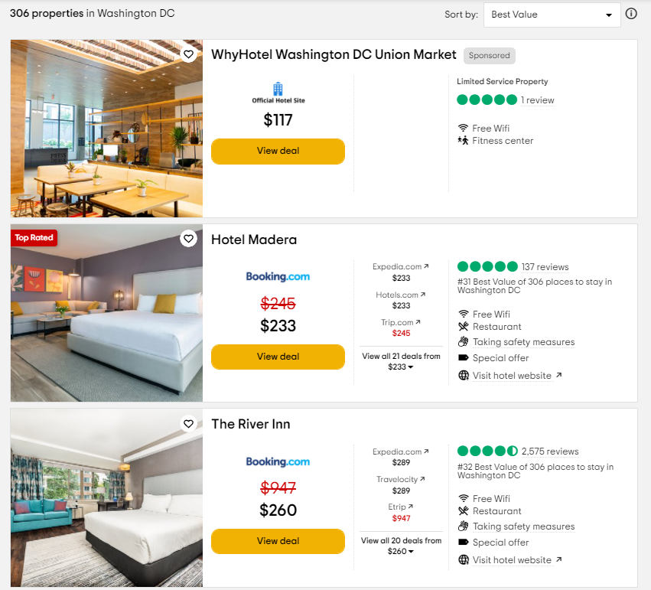
Dataset - Cities
For each State, download reviews for the most populous city
Exception: Connecticut – New Haven instead of Bridgeport
For each City, capture the number of properties, and loop through all pages of listings.
Hotel Listing
Collect link to hotel page if there are more than 50 reviews for the property
This saves time, especially as many small properties do not have any reviews.
Page Sorting
The default sorting system weights for number of reviews, as well as star rating and cost
Once more than half of the page has less than 50 reviews, stop scraping for hotel links.

Slide 42
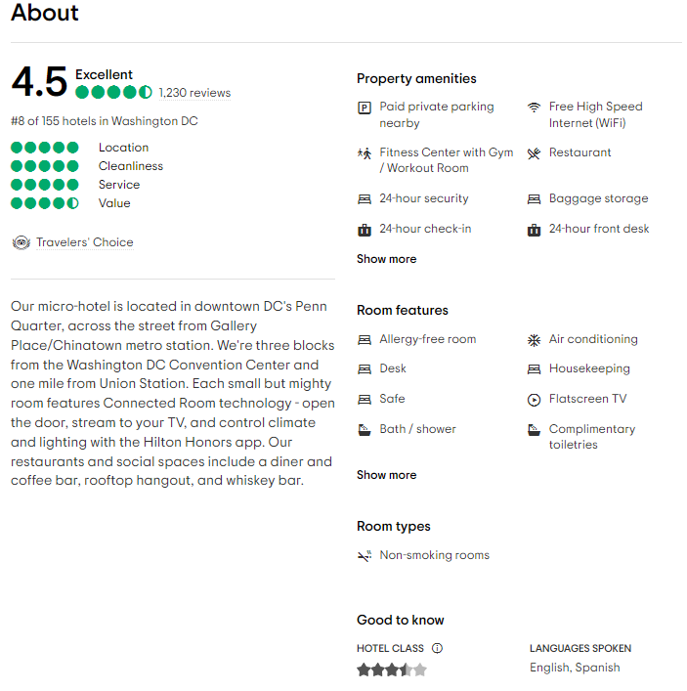
Methodology – Data Collection
Hotel ID
Unique ID code combining the city and hotel ID
Hotel Basic Information Section
Hotel name
Number of reviews
Hotel address
About Section
Hotel blurb
Property amenities and Room features
Hotel star rating
Location Section
Walkability score
Restaurants within distance
Attractions within distance

Slide 43
Methodology - Data Collection
Hotel ID
Review Information
Star rating
Title
Text of the actual review
Date of the stay
Reviewer Information
Date review written
Reviewer home location
Maximum of 4000 reviews per hotel
Necessary, as many large hotels have 30,000+ reviews, and reviews are displayed in increments of 5.
For most highly reviewed hotels, this puts us into reviews from 2017.

Slide 44
Feature Extraction - Categorization
Full Dataset
Includes all reviews, irrespective of location, star rating, and date
Quality of Stay
Good – Review rating of 4 stars or greater
Bad – Review rating of 2 stars or less
Pandemic
Pre-Pandemic – Before February 1st 2020
Pandemic – After and including February 1st 2020

Slide 45
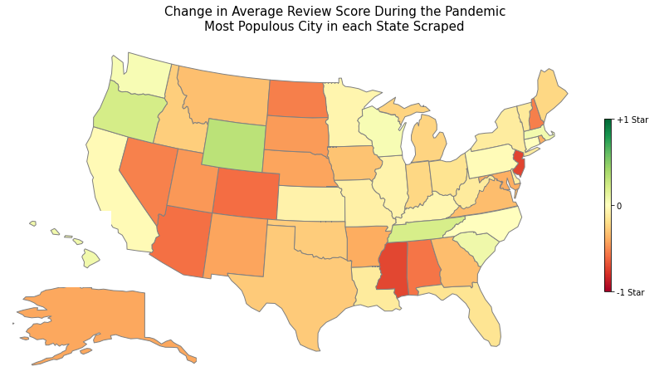
Results & Analysis – Change in Reviews

Slide 46
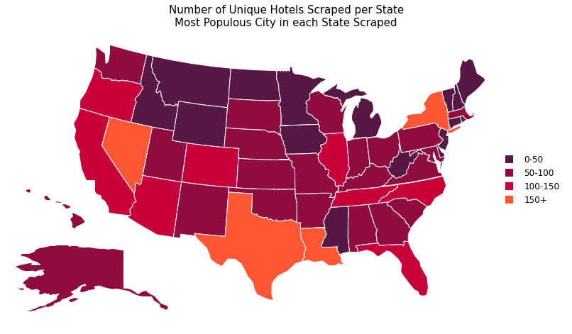
Results & Analysis– Hotels by State
Notes:
Min value: RI with 16 hotels, max Texas with 218

Slide 47
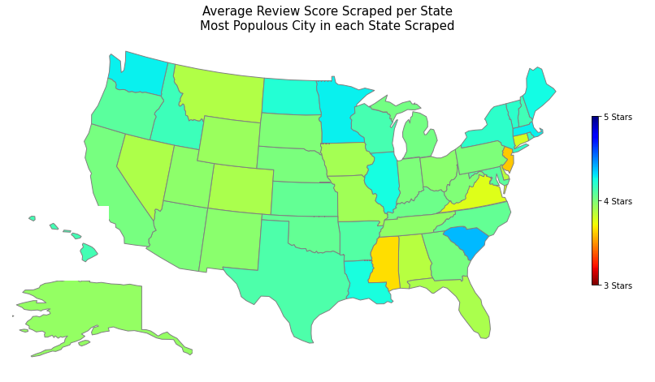
Results & Analysis – Average Review by State

Slide 48
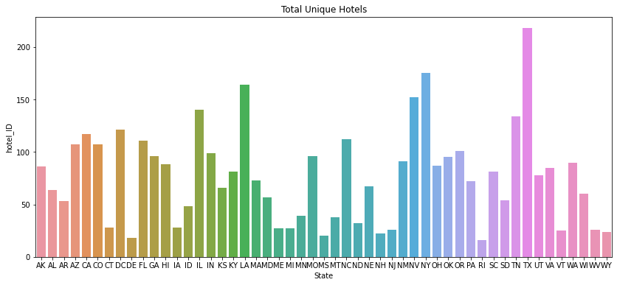
Total Unique Hotels by State

Slide 49
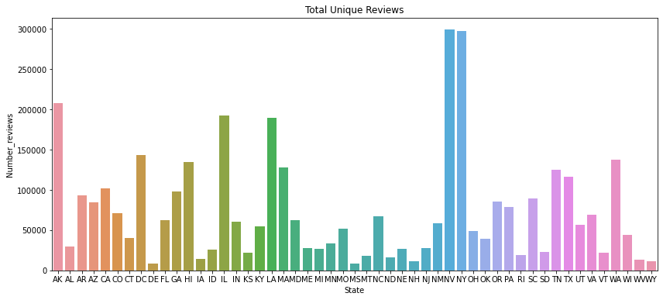
Total Unique Reviews by State

Slide 50
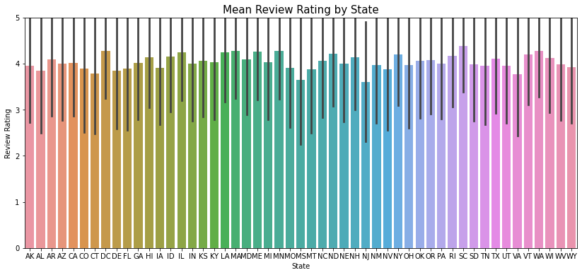
Mean Review by State with STD

Slide 51
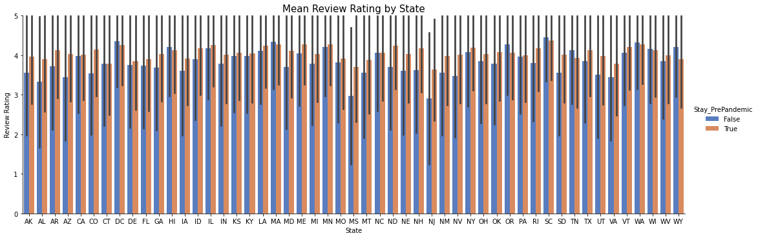
Change in Reviews by State – Pre and during Pandemic

Slide 52
Results & Analysis – Feature Extraction
Ranking | Full Dataset | Good | Bad | Pre-Pandemic | Pandemic
0 | hotel | hotel | room | hotel | room
1 | room | room | hotel | room | hotel
2 | great | great | stay | great | great
3 | stay | stay | night | stay | stay
4 | staff | staff | would | staff | staff
5 | nice | nice | one | nice | clean
6 | location | location | staff | location | nice
7 | good | clean | desk | good | service
8 | clean | good | bed | clean | location
9 | breakfast | breakfast | service | breakfast | time
10 | service | friendly | front | service | good

Slide 53
Results & Analysis – Feature Extraction
Ranking | Full Dataset | Good | Bad | Pre-Pandemic | Pandemic
0 | hotel | hotel | room | hotel | room
1 | room | room | hotel | room | hotel
2 | great | great | stay | great | great
3 | stay | stay | night | stay | stay
4 | staff | staff | would | staff | staff
5 | nice | nice | one | nice | clean
6 | location | location | staff | location | nice
7 | good | clean | desk | good | service
8 | clean | good | bed | clean | location
9 | breakfast | breakfast | service | breakfast | time
10 | service | friendly | front | service | good
Clean = 28
Notes:
Note: for Bad, Dirty is #19.

Slide 54
Results & Analysis – Feature Extraction
Ranking | Full Dataset | Good | Bad | Pre-Pandemic | Pandemic
0 | hotel | hotel | room | hotel | room
1 | room | room | hotel | room | hotel
2 | great | great | stay | great | great
3 | stay | stay | night | stay | stay
4 | staff | staff | would | staff | staff
5 | nice | nice | one | nice | clean
6 | location | location | staff | location | nice
7 | good | clean | desk | good | service
8 | clean | good | bed | clean | location
9 | breakfast | breakfast | service | breakfast | time
10 | service | friendly | front | service | good
Breakfast = 22
Breakfast = 14

Slide 55
Results & Analysis – Novel Sentences
Sentence | Electra | Ernie | DeBERTa | Ensemble
I wrote my capstone in this hotel. The desk was a little small. | 3 | 3 | 3 | 3
I wrote my capstone in this hotel. The desk was a little small, but the room was spotless. | 4 | 4 | 3 | 4
I wrote my capstone in this hotel. The desk was a little small, but the room was spotless. Breakfast was absolutely terrible though! There was no coffee!! | 3 | 2 | 2 | 2

Slide 56
Results & Analysis – Old Model Feature Engineering
Features | Accuracy | MSE
Predict most frequent rating | 0.4739 | 2.467
Review body only | 0.6993 | 0.402
Review body + Pandemic Timing | 0.6814 | 0.400
Review body + Pandemic Timing + State | 0.6895 | 0.410
Review body + Pandemic Timing + State + Walkability | 0.64215 | 0.542
Review body + Walkability | 0.68627 | 0.423
Review body + State | 0.6732 | 0.4722
Review body + State + Walkability | 0.6797 | 0.435

Slide 57
Results & Analysis – Old Ensemble Results
Baseline | Accuracy | MSE
Electra | 0.729 | 0.317
Ernie | 0.729 | 0.331
DeBERTa | 0.717 | 0.352
Electra + Ernie + DeBERTa GradBoost Ensemble | 0.734 | 0.316
Notes:
Part of what makes the results very similar, and the ensemble less effective than expected is that they often made errors on the same test cases. These were often reviews that had discordant review ratings and text, or ones with edits that change the rating dramatically, but are short in length.

Slide 58
Results & Analysis – New Ensemble Results
Baseline | Accuracy | MSE
Electra | 0.7353594 | 0.3116013
Ernie | 0.729150 | 0.327549
DeBERTa | 0.731307 | 0.319771
Electra + Ernie + DeBERTa GradBoost Ensemble | 0.739673 | 0.305392
Notes:
Part of what makes the results very similar, and the ensemble less effective than expected is that they often made errors on the same test cases. These were often reviews that had discordant review ratings and text, or ones with edits that change the rating dramatically, but are short in length.

